Slide 1

Correlation Between Advertisement Sales
By: Ricky, Jason & Sergio

Slide 2
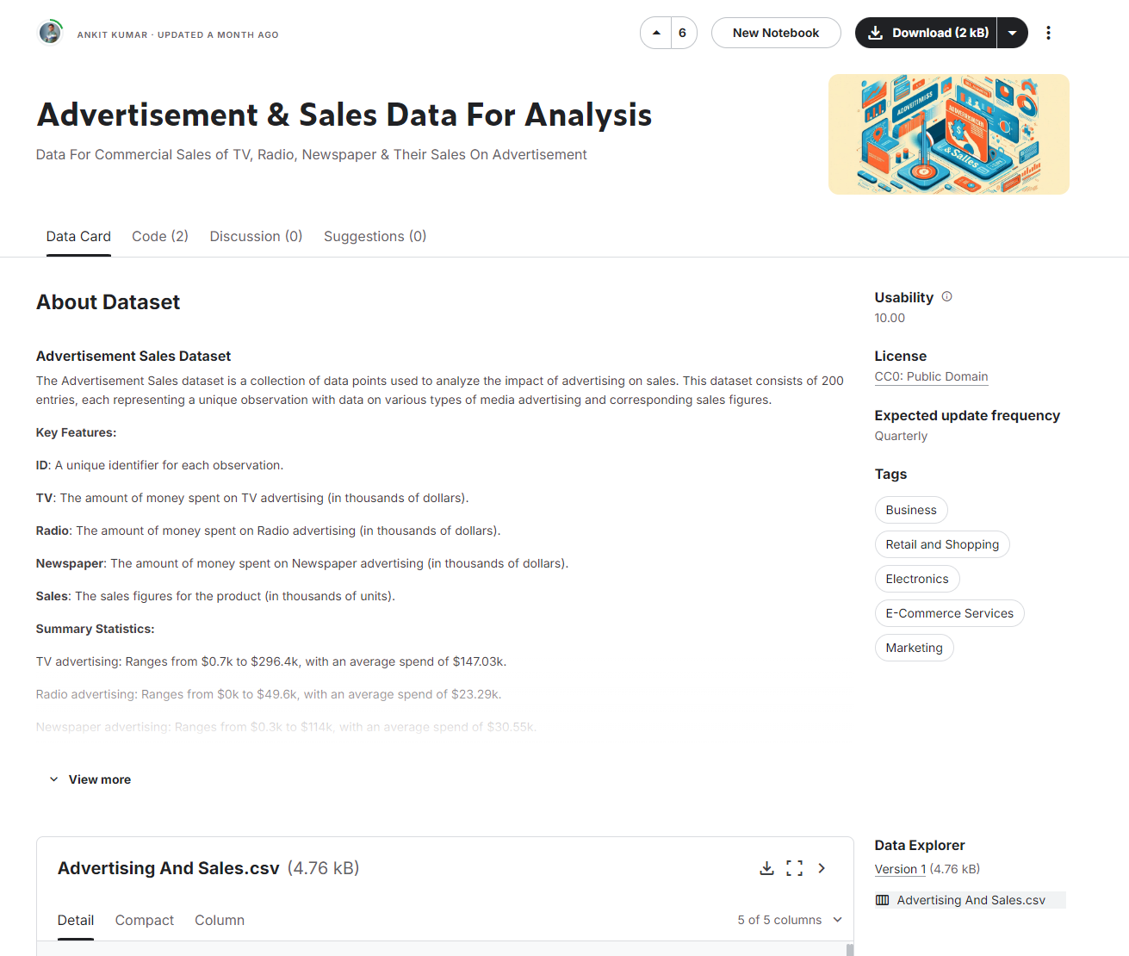
Original Dataset Website
Website Resource: Advertisement & Sales Data For Analysis (kaggle.com)

Slide 3

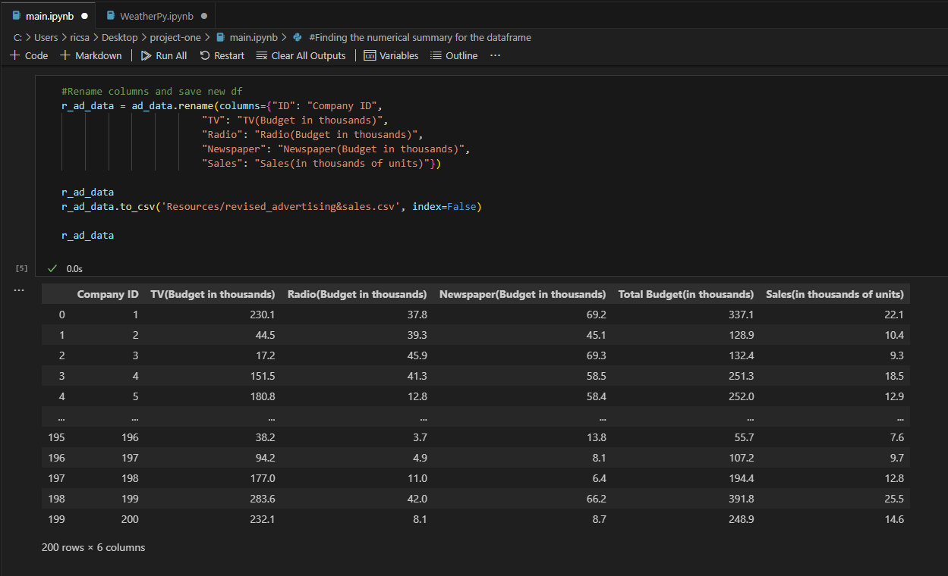
Cleaning & Revising Data

Slide 4
Questions To Answer
Which advertisement is most and least effective?
Can we find if companies focused more budget into one type of media, and if that had an effect on sales?
Can you predict the future sales based on the type of advertisement
How do the budgets compare between the highest and lowest selling companies?

Slide 5
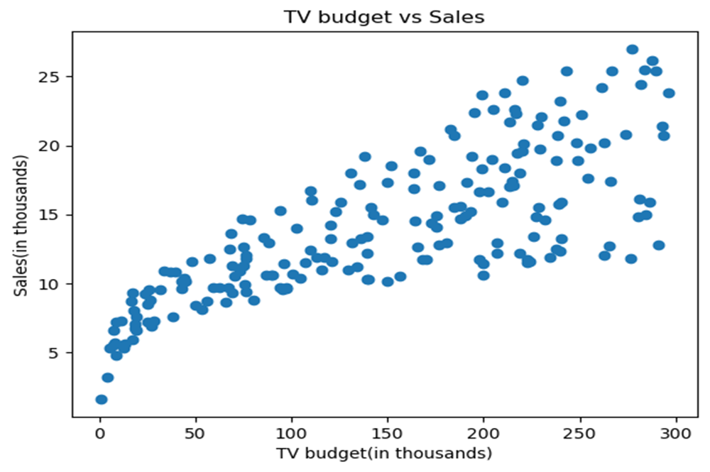
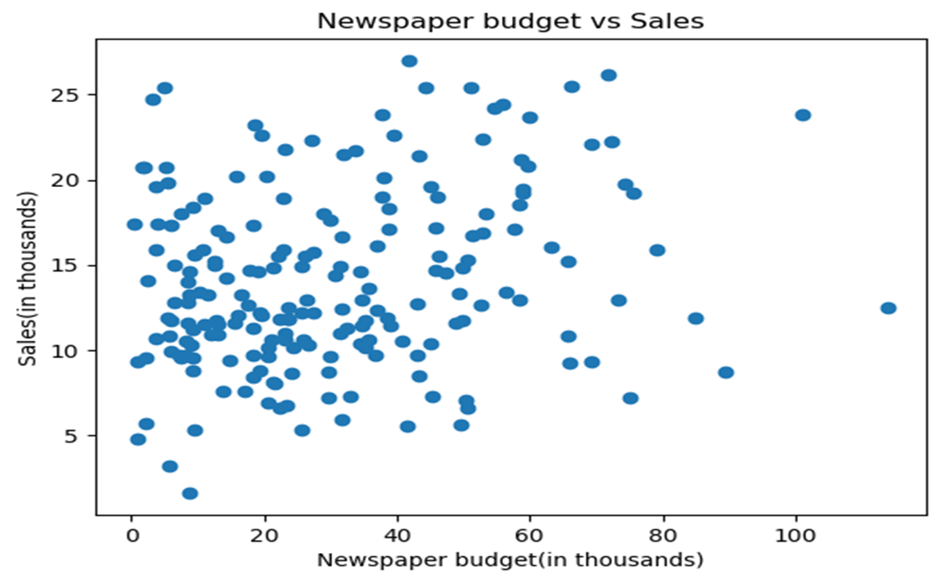
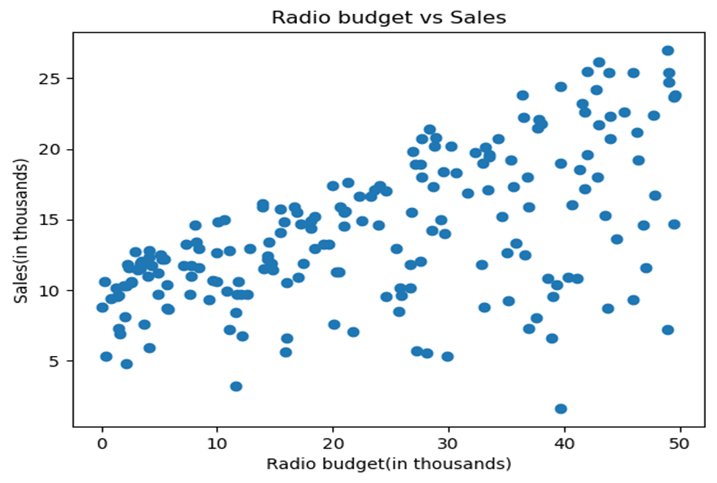
Which advertisement is most and least effective?

Slide 6
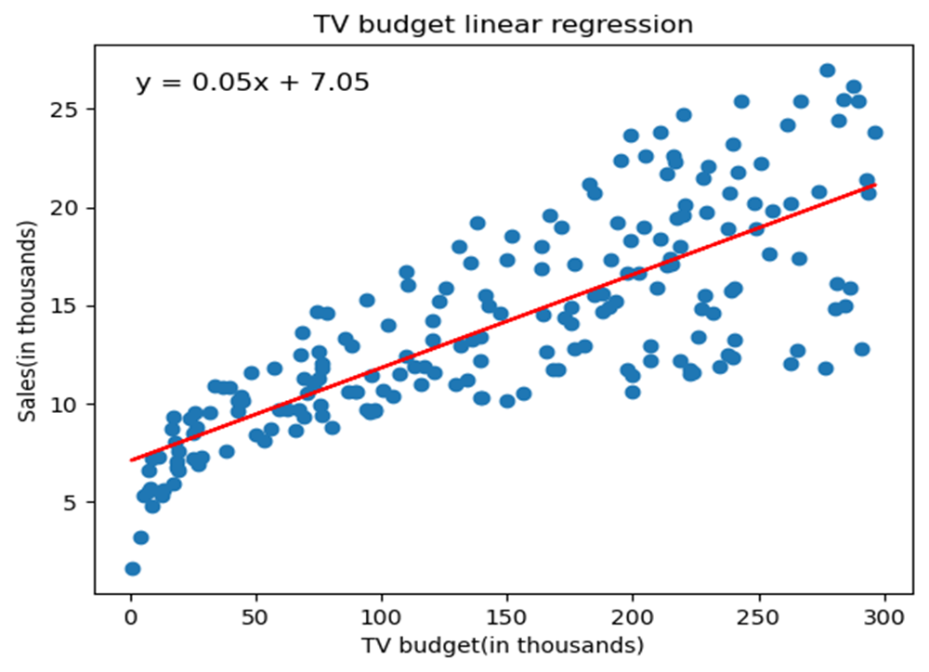
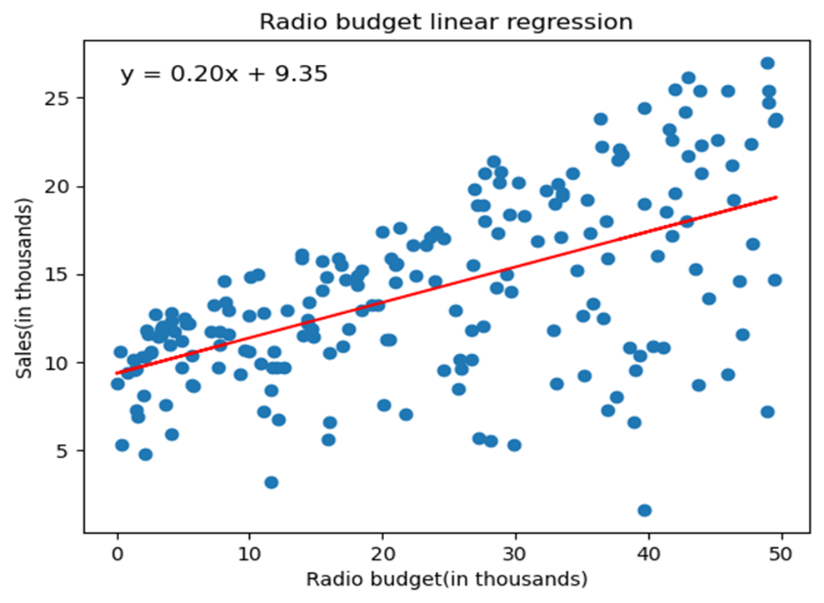
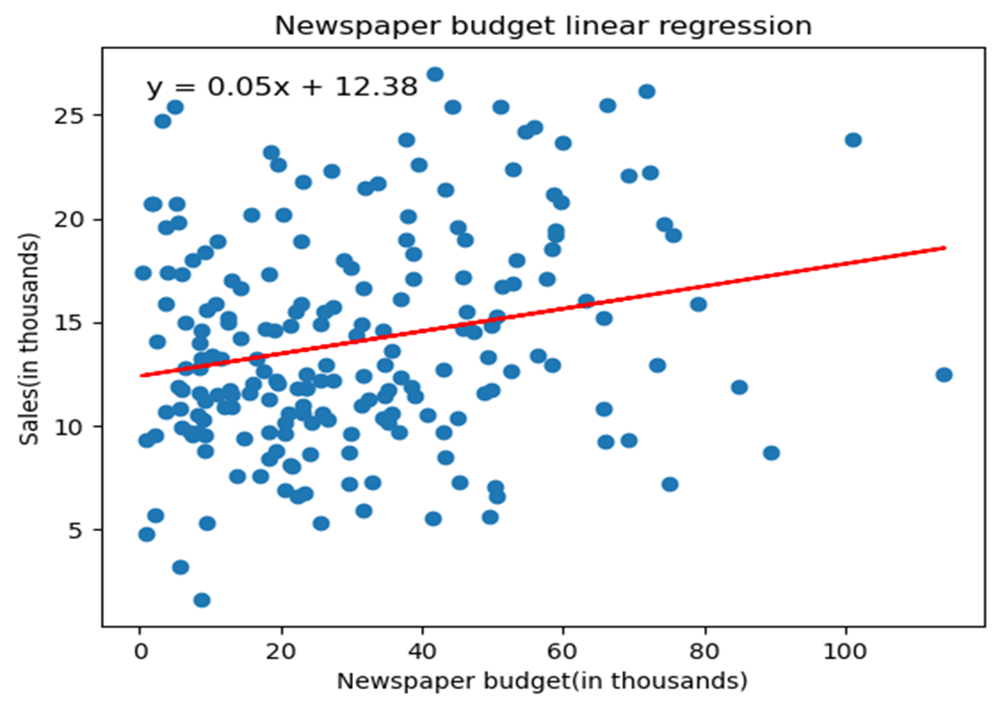
Predictions Based Off Linear Regression

Slide 7
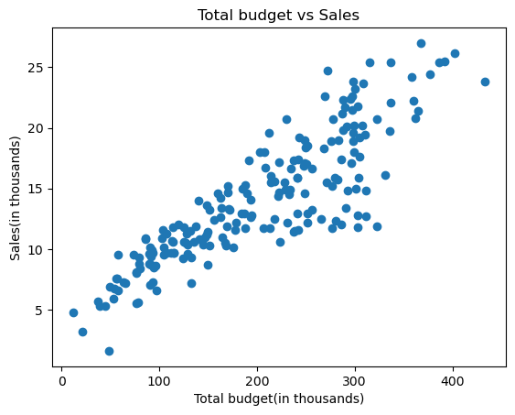
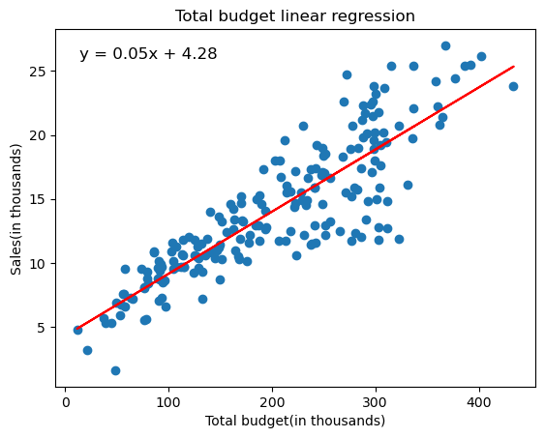
Total Budget Visualization & Prediction

Slide 8
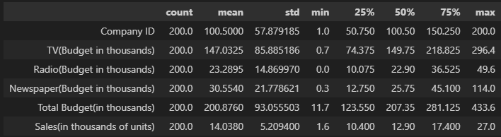
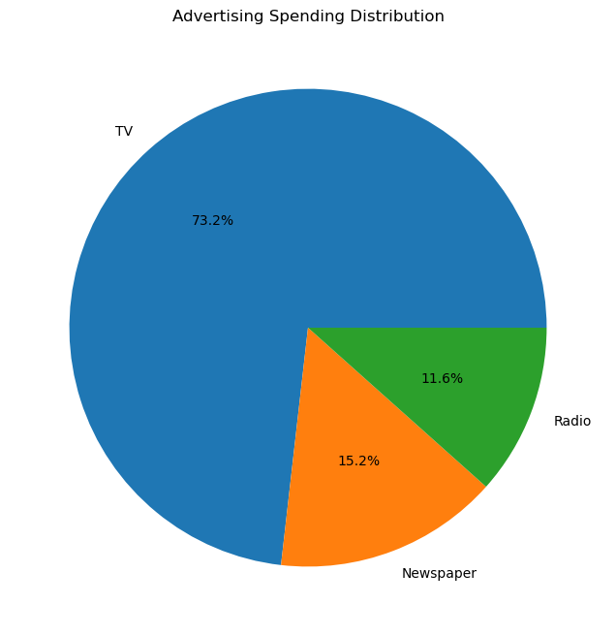
Numerical Summary & Spending Distribution

Slide 9
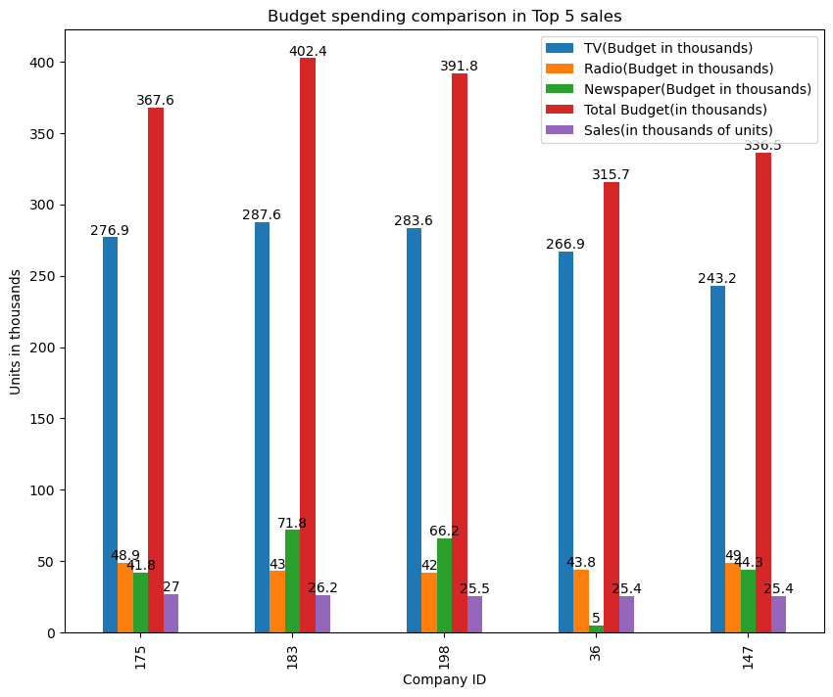
Correlation between advertising spending and Sales Performance For Best Performing Companies

Slide 10
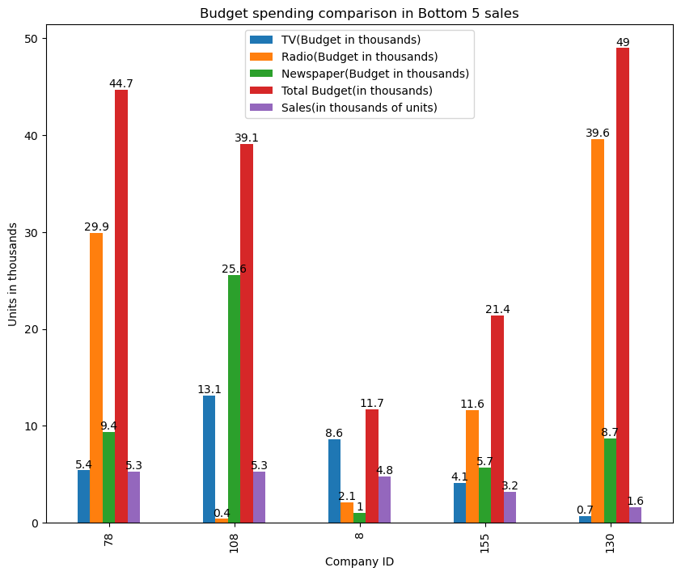
Correlation Between Advertising Spending And Sales For Worst Performing Companies

Slide 11
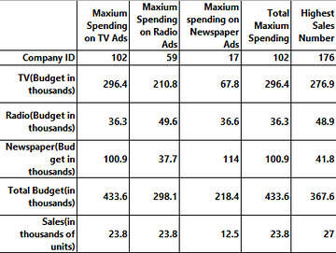
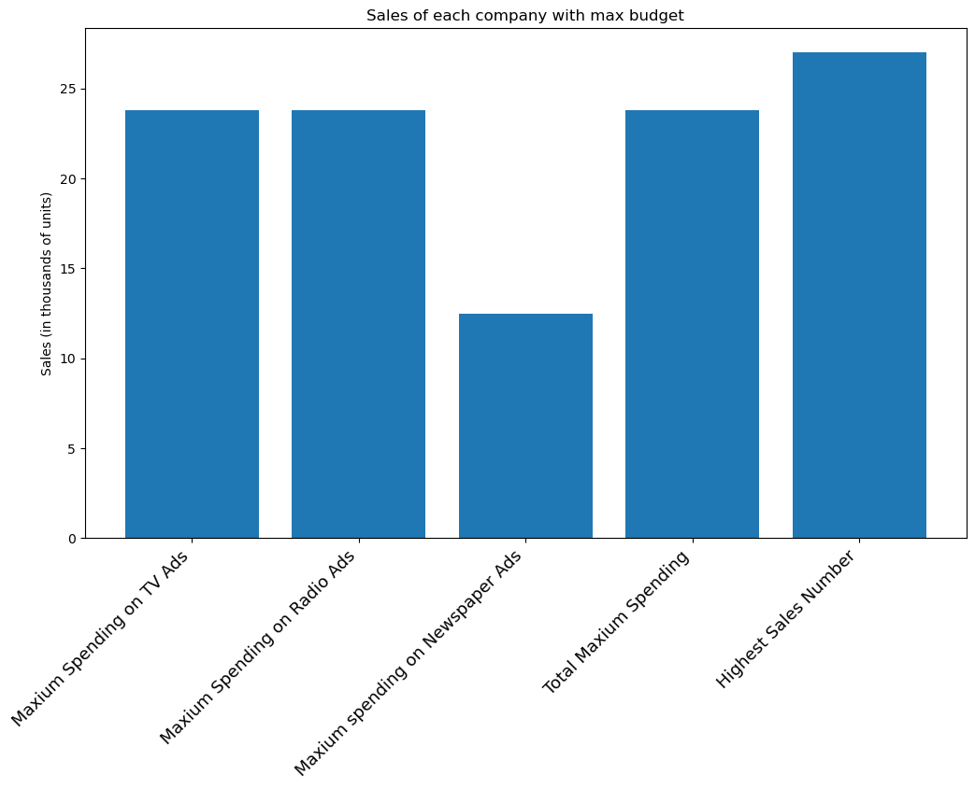
Summary Of Each Company With Maximum Budget

Slide 12
Conclusion & Further Questions
With this dataset, Tv seems to be the most effective type of advertisement and newspaper is the least effective. The companies that spent less on Tv ended up with the least amount of sales.
We can most effectively predict the sales based off tv budget. One limitation of this dataset is that the tv budget skews the total budget data.
Would you find similar conclusions from this data with current advertising practices? i.e. internet advertising

